Slide 1

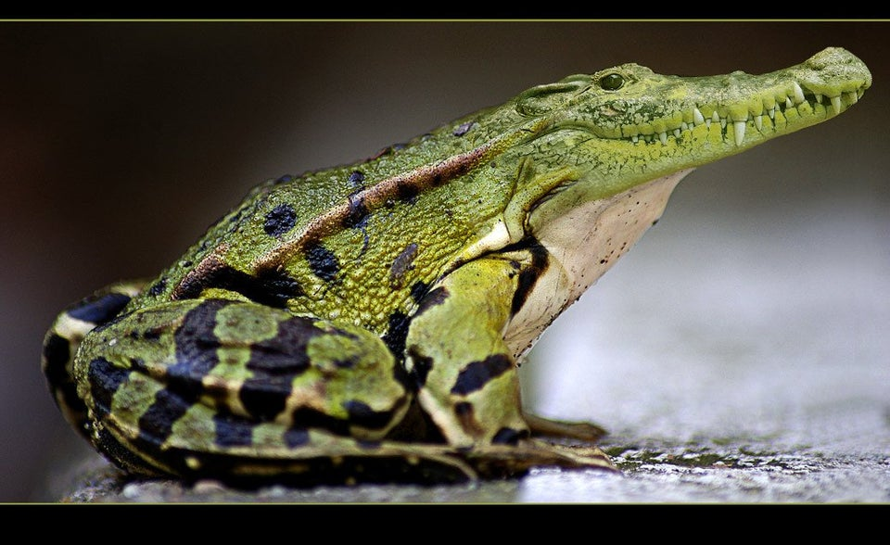

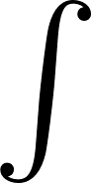
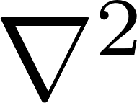
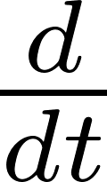

: Scalable, Efficient and Accelerated Causal Reasoning
Operators, Graphs and Spikes for Earth and Embedded Systems
SEA-CROGS
Graph
Networks
Neural
Operators
Spiking
Neural Networks
leading the path towards
Scalable-Efficient-Accelerated
Causal Reasoning Operators-Graphs-Spikes
https://www.pnnl.gov/projects/sea-crogs

Slide 2
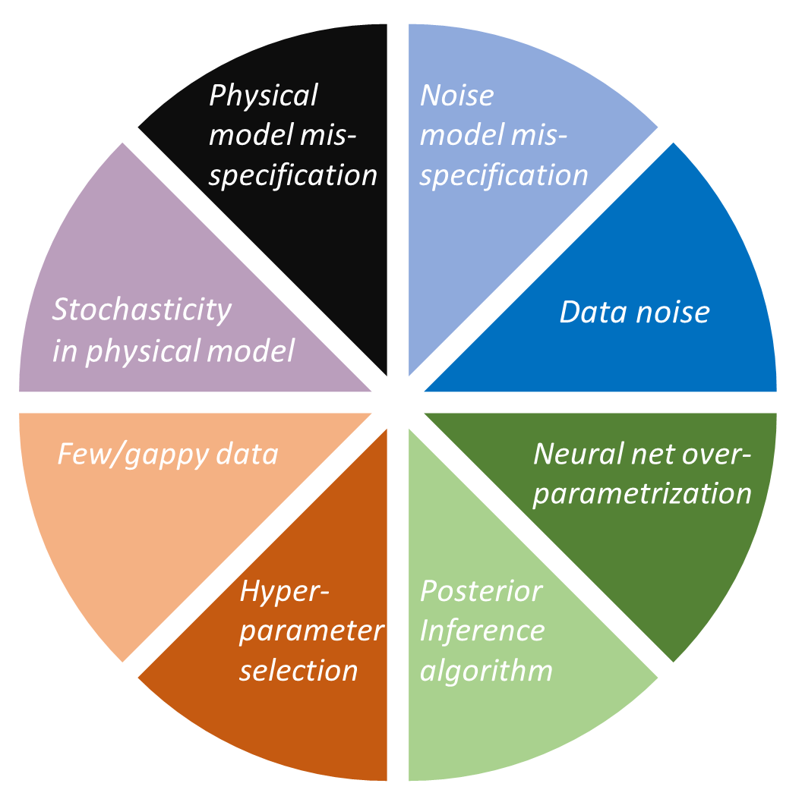
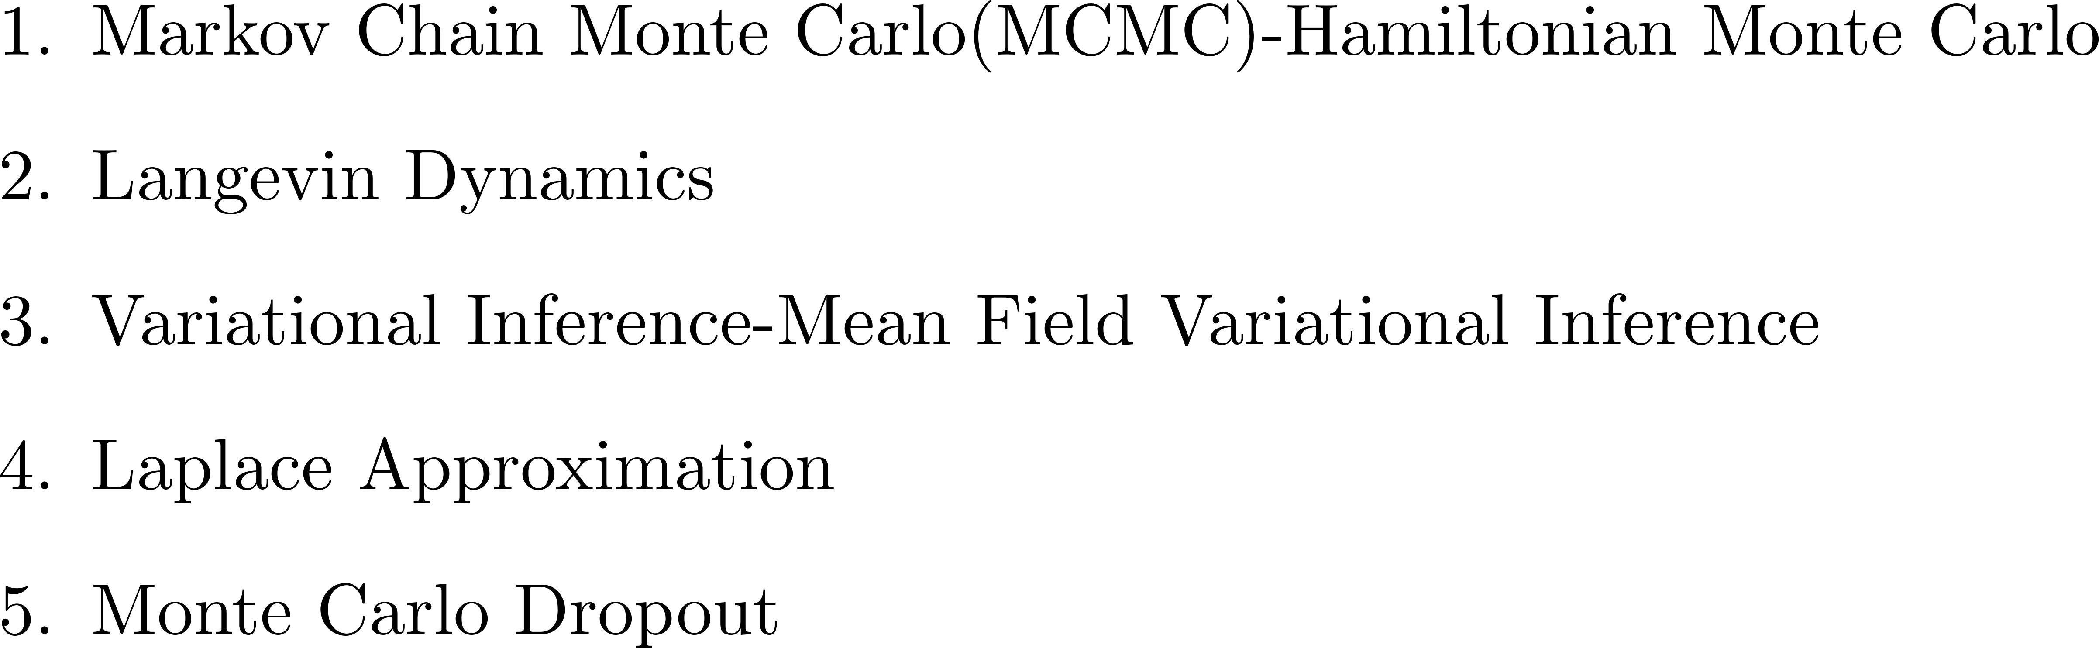

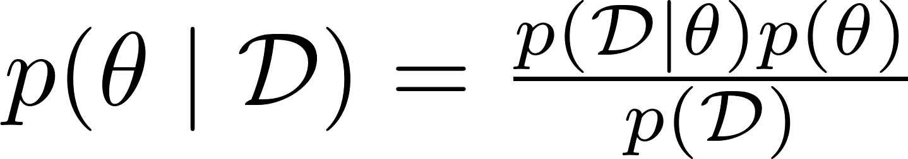
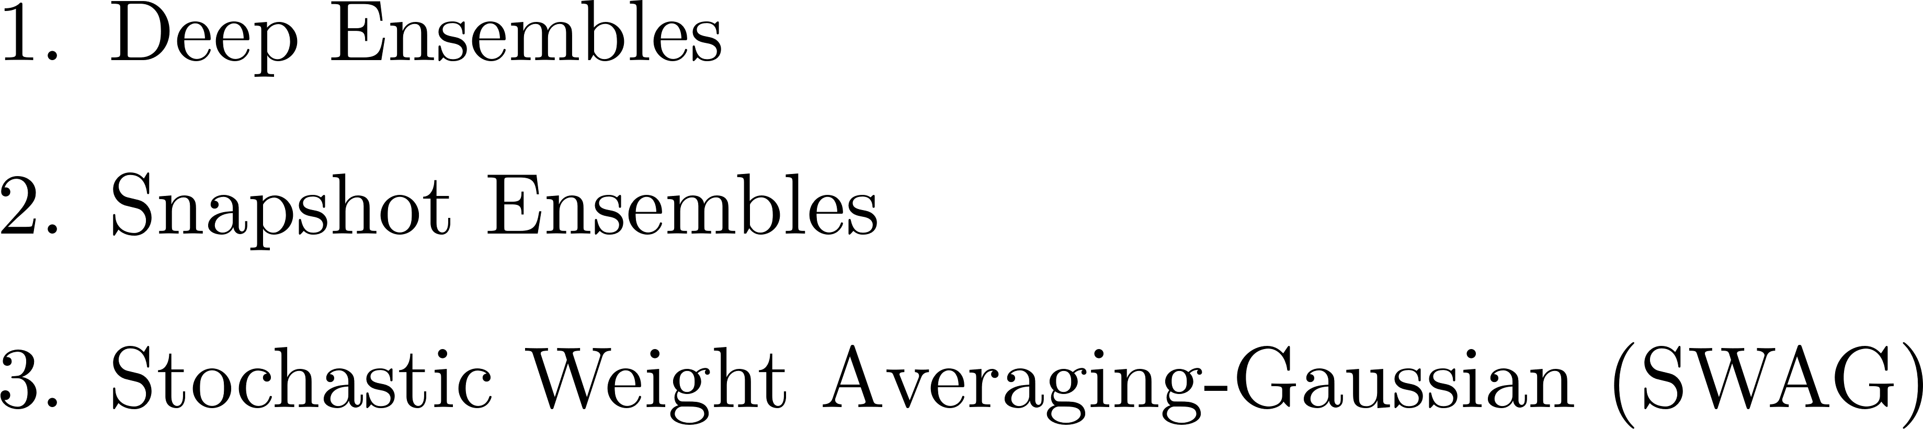

Total Uncertainty
Release of New Library NeuralUQ
Methods for UQ
NeuralUQ: A comprehensive library for uncertainty quantification in neural differential equations and operators. Z Zou, X Meng, AF Psaros, GE Karniadakis, arXiv preprint arXiv:2208.11866, 2022, SIREV.
Psaros AF, Meng X, Zou Z, Guo L, Karniadakis GE. Uncertainty Quantification in Scientific Machine Learning: Methods, Metrics, and Comparisons. arXiv preprint arXiv:2201.07766. 2022 Jan 19 (Journal of Computational Physics, 104 pages).

Slide 3
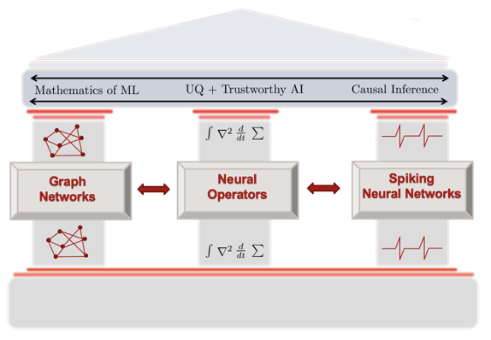
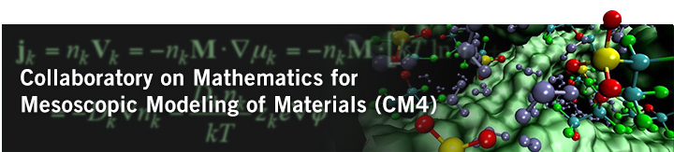

From Physics-Informed Machine Learning to Physics-Informed Machine Intelligence
Objective
Mathematics of next-generation ML to support CROGS of complex systems
Focus
Performance – 1000x faster solvers
Efficiency – 10x lower power
Hardware/software co-design
Workforce development
2011-2016 2018-2022 2022-2027
Notes:
The long history…but new focus with a new team.

Slide 4
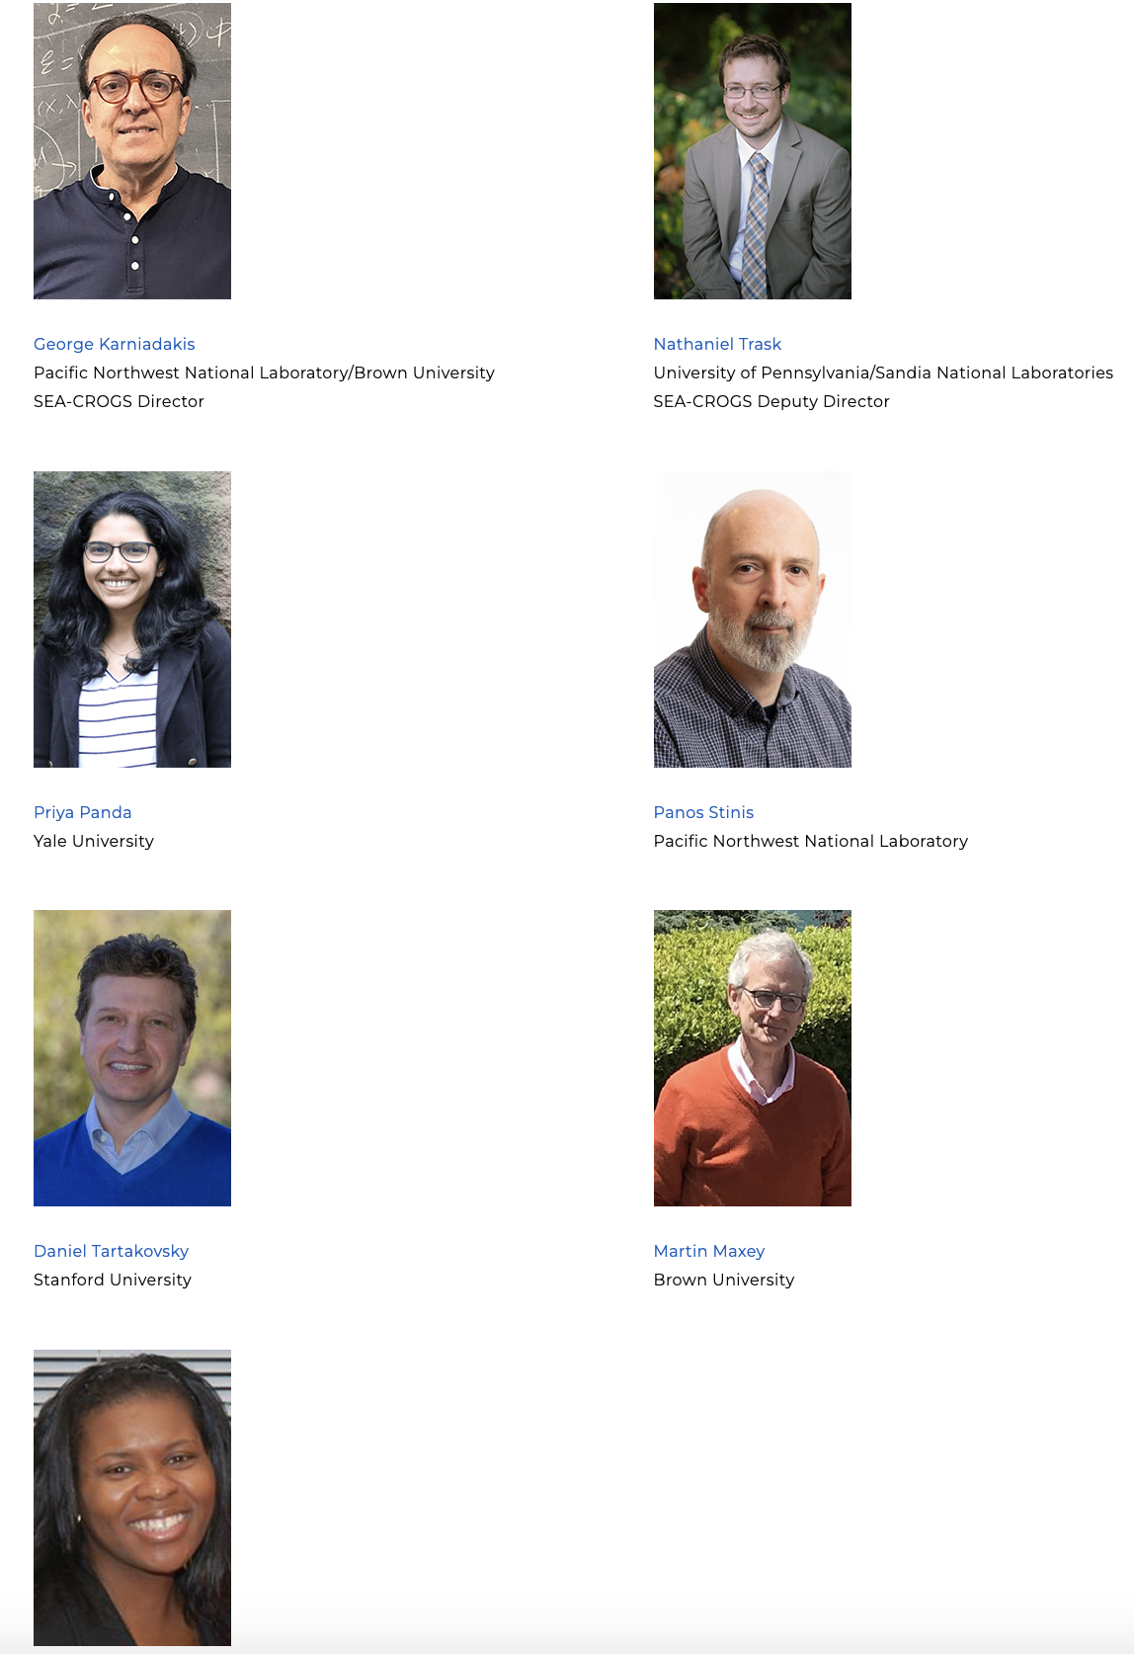




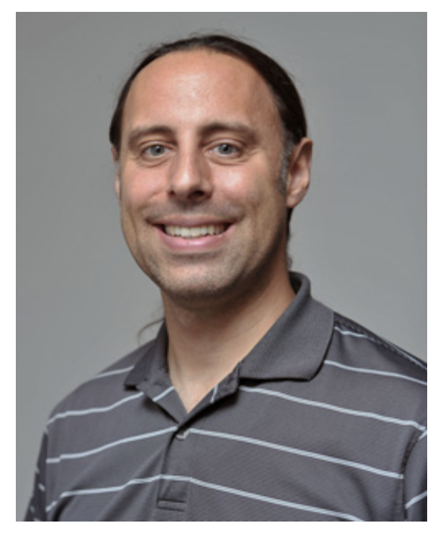



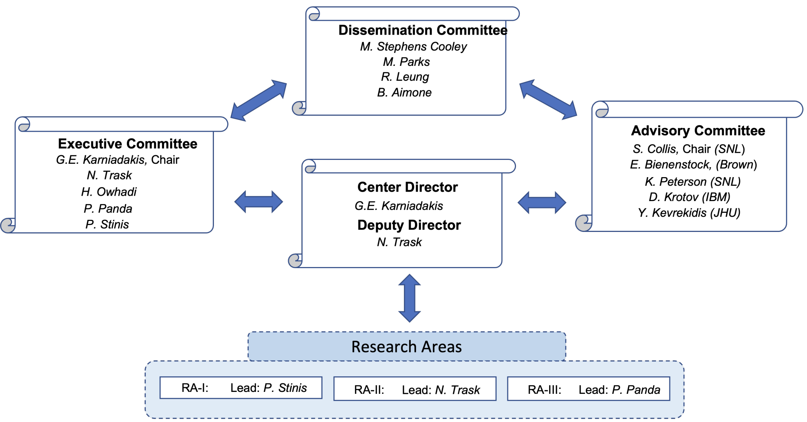
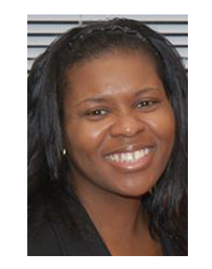
SEA-CROGS Leadership Team
Research Team
Pacific Northwest
National Laboratory
Amanda Howard, Wenqian Chen, Ruby Leung,
Shixuan Zhang
Sandia
National Laboratory
Mauro Perego, Brad Aimone, Eric Cyr, Jonas Actor, Justin Owen,
Elise Walker, Brad Theilman
George Karniadakis
Nathaniel Trask
Brown University
Jerome Darbon, Thomas Serre, Aniruddha Bora, Khemraj Shukla
Brown University/PNNL
SEA-CROGS Director
UPenn
SEA-CROCS Deputy Director
California Institute
of Technology
Houman Owhadi, Theo Bourdais, Pau Batlle, Yasamin Jalalian,
Xianjin Yang, Ricardo Baptista
New Jersey
Institute of Technology
Mengjia Xu
Spelman College
Erdi Kara
Eric Cyr
Priya Panda
Stanford University
Adrienne Propp, Hongli Zhao, Abhishek Chandra
SNL
Yale University
Panos Stinis
Daniel Tartakovsky
PNNL
Stanford University
Martin Maxey
Monica Stephens Cooley
Brown University
Speiman College
Notes:
Over 50% new members: Caltech, Stanford, Spellman

Slide 5
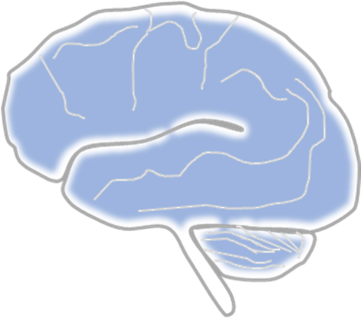
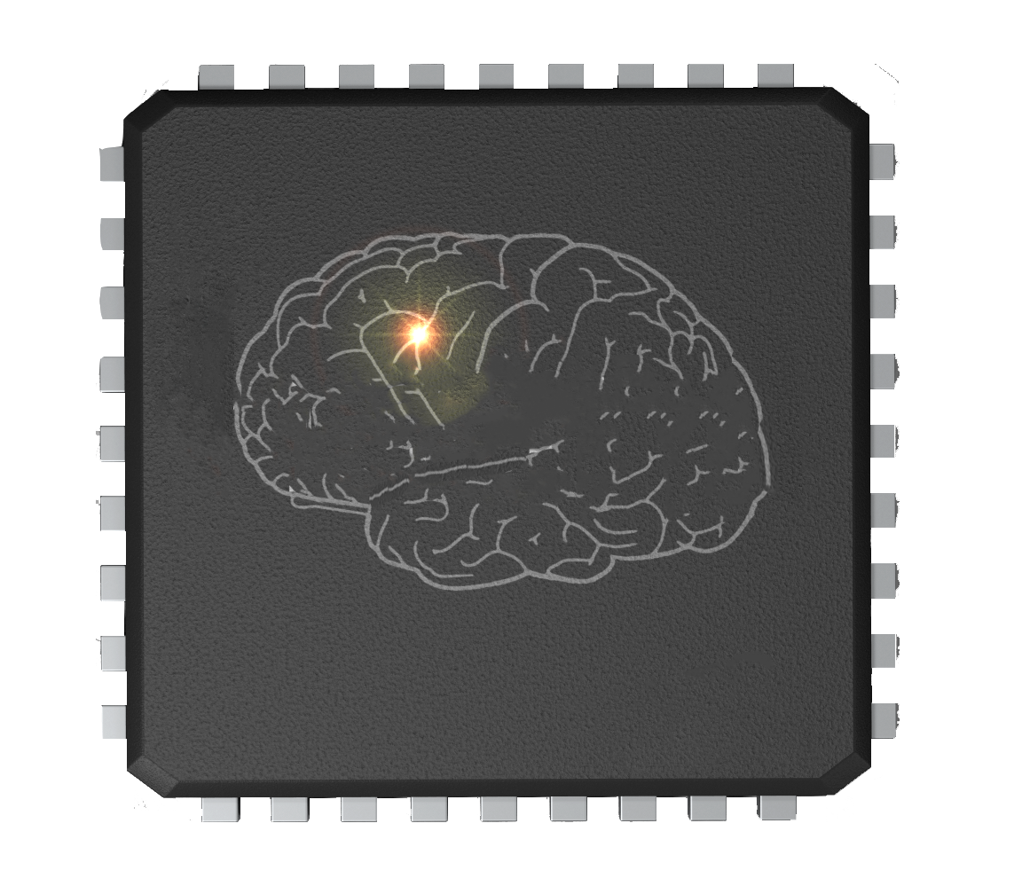
What Constitutes Brain Inspiration?
High fan-in connectivity!
Realized Features of Brain Inspiration in Neuromorphic Hardware
Event-driven communication
Graph based connectivity
Processing in Memory
In situ learning
Analog computation
Post-Moore’s Law Devices
Ubiquitous stochasticity
Analog computing!
Realized Today for 10x-100x energy savings
Learning!
Spiking!
Stochasticity!
Active Research for additional power savings

Slide 6
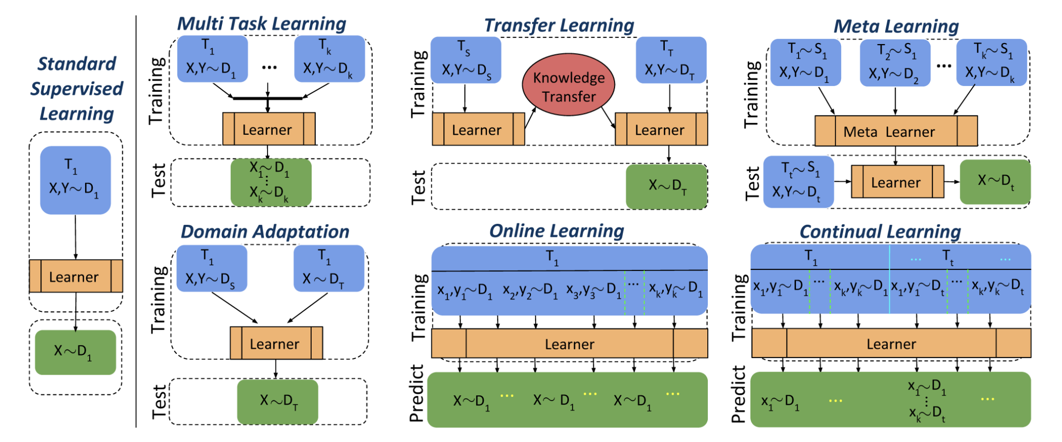
Types of Machine Learning: Concepts
De Lange, Matthias, et al. "A continual learning survey: Defying forgetting in classification tasks." IEEE transactions on pattern analysis and machine intelligence 44.7 (2021): 3366-3385.

Slide 7
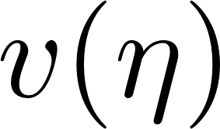
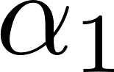
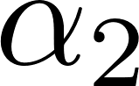
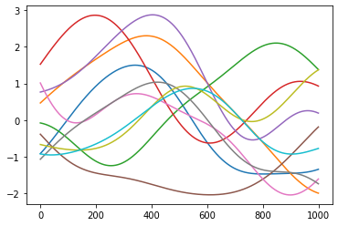
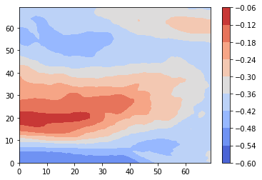
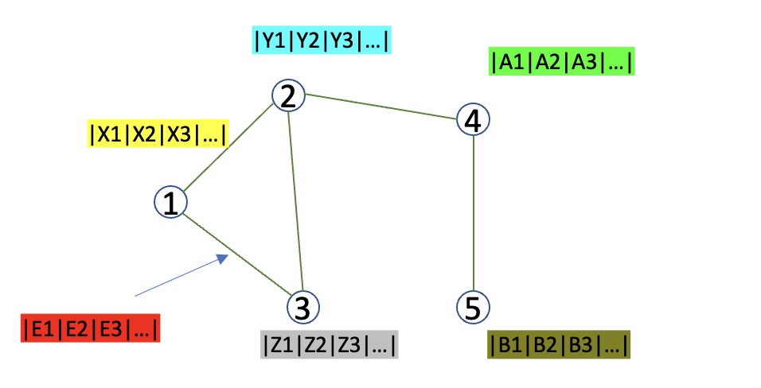
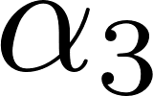
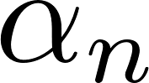
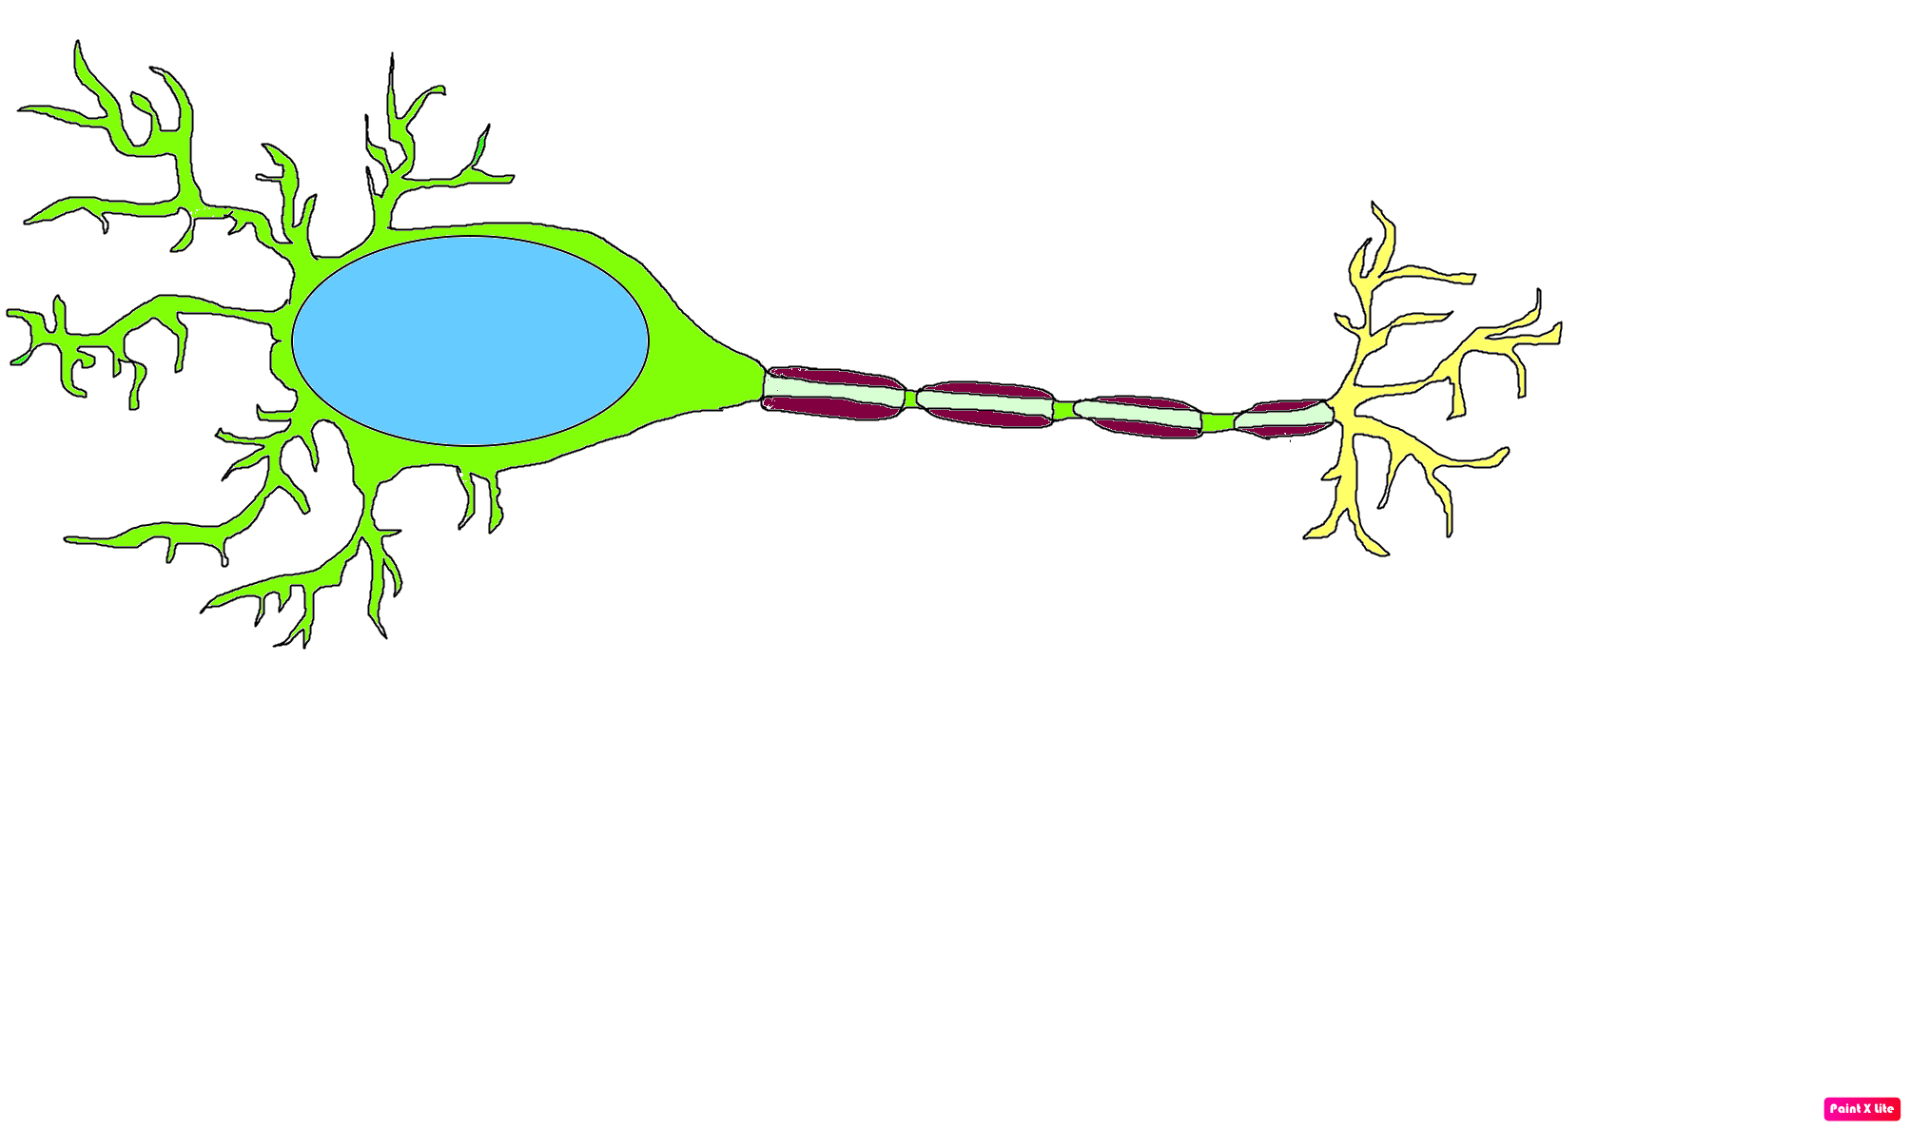
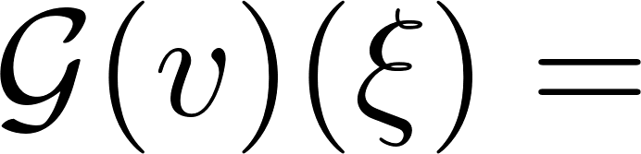
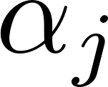
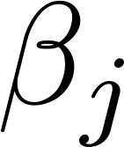




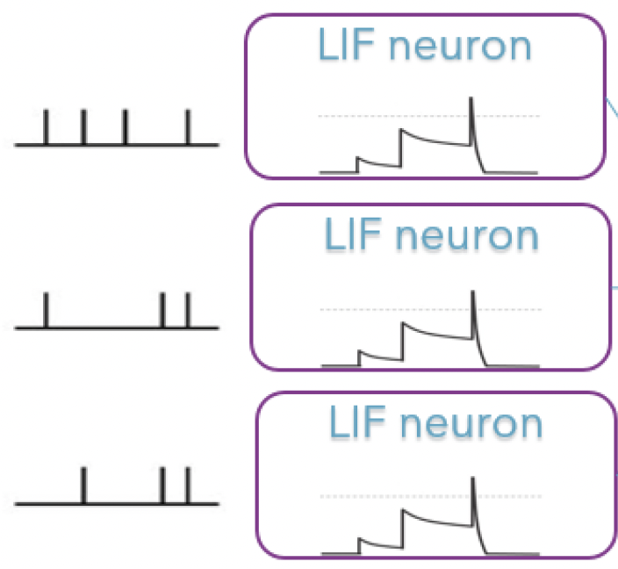
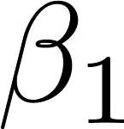
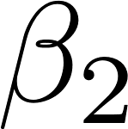
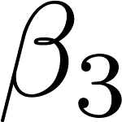
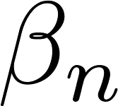
DeepOnet Provides a Plurality of Neural Operators
Basis Coefficients
Branch Input
Features
Branch Net
DNNs
GNNs
SNNs
.
.
.
1-D feature
2-D feature
Hierarchical
graph data
Trunk Input
Co-ordinates
Basis Functions
Spikes
Trunk Net
DNNs
GNNs
SNNs
.
Vertices/Edges
.
.

Slide 8
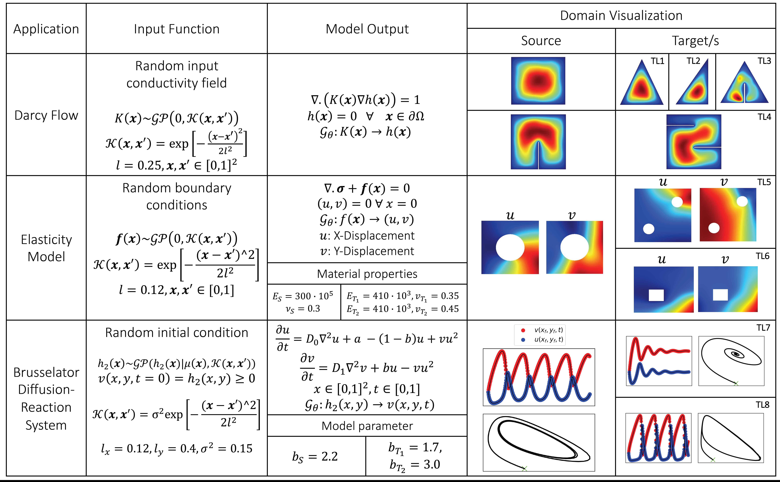
Deep Neural Operator Transfer-Learning
Applications
Transfer-Learning has continuous learning but stops after a few attempts; it does not care about the performance of the source task when transferring knowledge (hence only forward transfer).
Deep transfer operator learning for partial differential equations under conditional shift for partial differential equations under conditional shift , Goswami et al, Nature Machine Intelligence (December, 2022)

Slide 9
Deep Neural Operator Multi-Tasking
Notes:
In this work our objective is to create a DeepONet Agent that can simultaneously be trained on multiple families of PDE or multiple geometries. In Application 1: we learn the fisher equation for multiple forms of RHS and also for a distribution of the parameters b and a and mapped the initial condition.

Slide 10
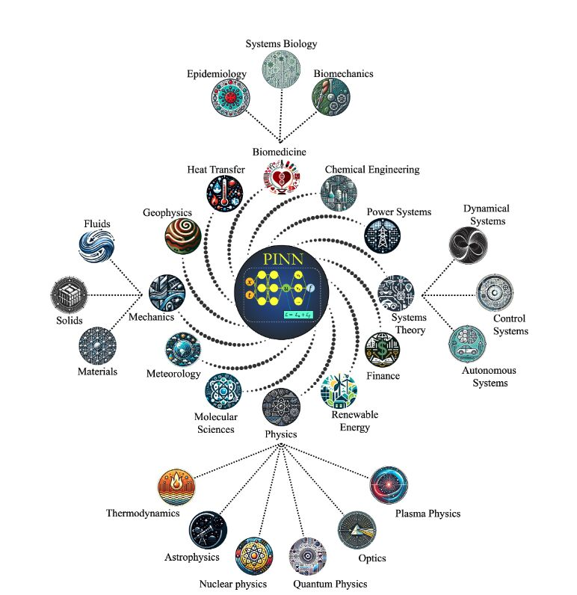
From PINNs to PIKANs: Recent Advances in Physics-Informed Machine Learning
https://arxiv.org/abs/2410.13228

Slide 11
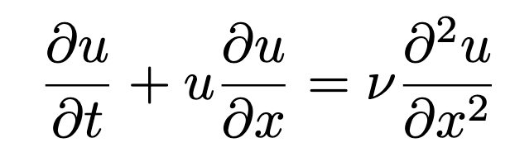
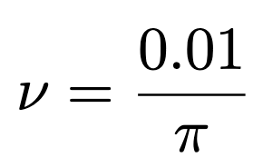
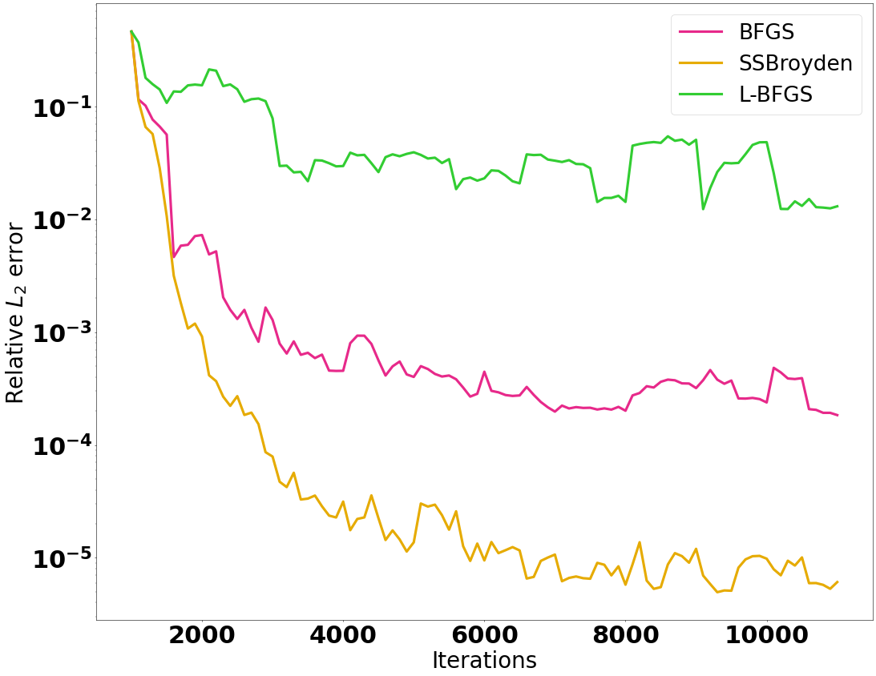
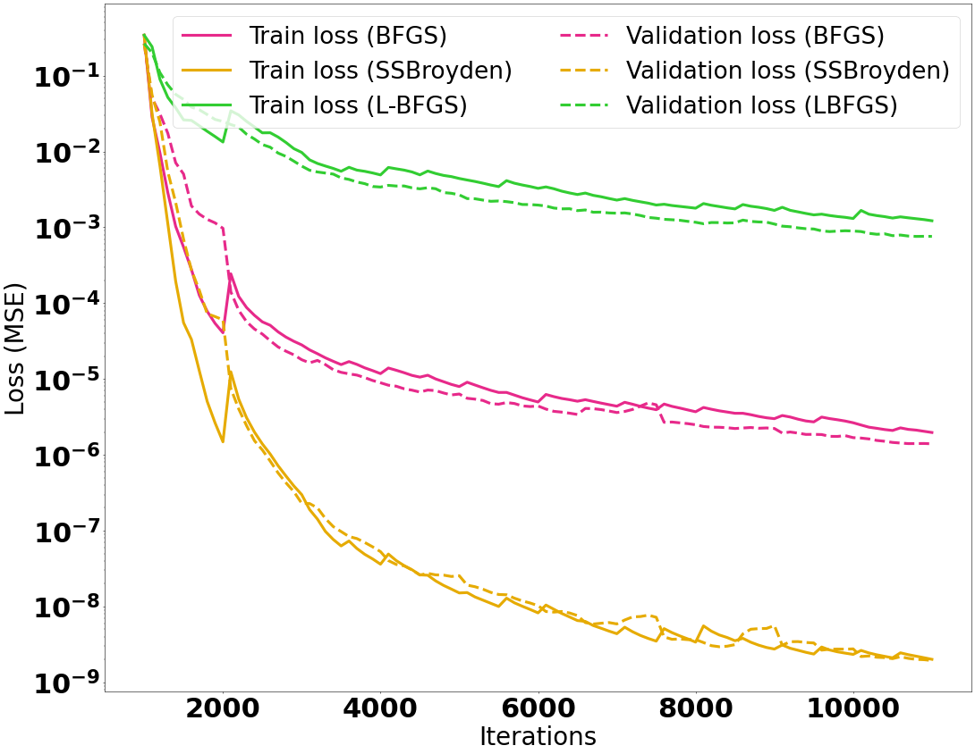
FASTER OPTIMIZATION: Self-Scaled Broyden’s Method

Slide 12
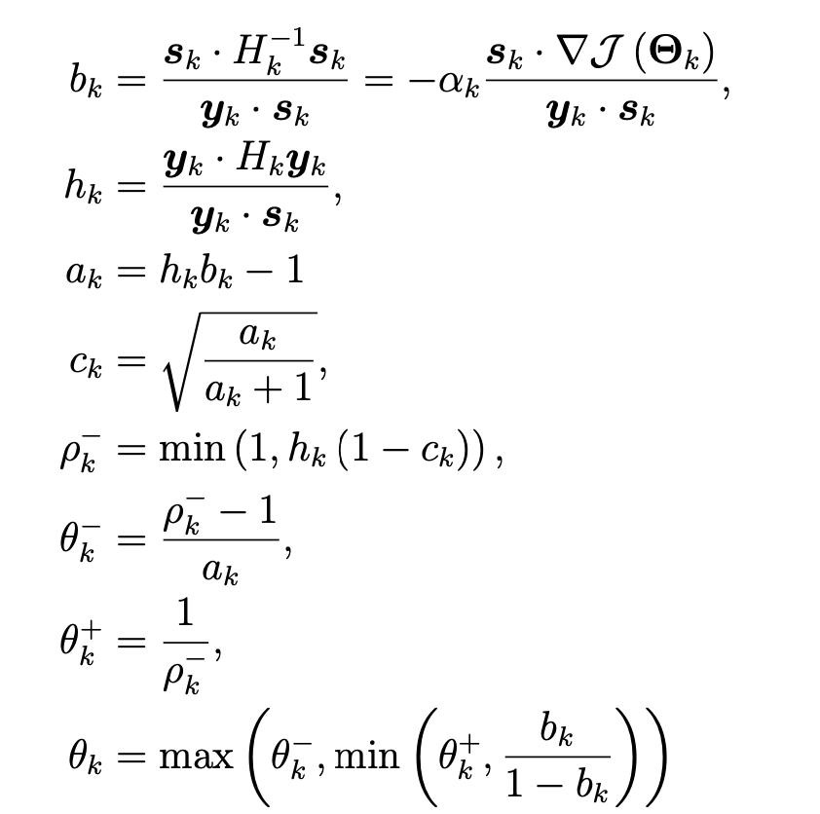
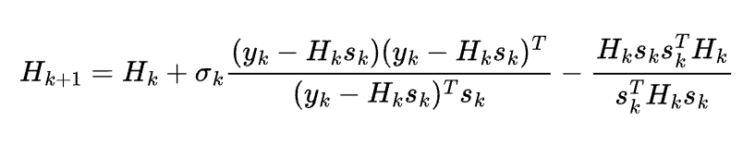
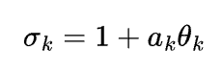
FASTER OPTIMIZATION: Self-Scaled Broyden’s Method
Instead of computing the inverse Hessian matrix directly, the algorithm reformulates
the scaling parameter calculation, avoiding the O(N³) complexity.

Slide 13

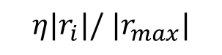
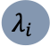
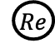


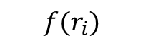
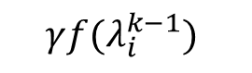
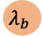

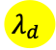




Residual Based Attention (RBA) Weights
(Anagnostopoulos et al., CMAME 2024)
Weighting strategies:
Modify loss terms contribution during training
Fixed global multipliers (per loss term):
Adaptive local multipliers (per training point):
Points
$$D$$
$$BC$$
$$Re$$
$$ℒ= {λ_{D}ℒ}_{Data}\text{+} λ_{B} ℒ_{BCs}+λ_{PDE}ℒ_{PDE}$$
Attention Mask
$$λ_{d}$$
$$λ_{b}$$
$$λ_{i}$$
$$ℒ=\left\langle {\left(λ_{d}⋅e_{d}\right)}^{2}\right\rangle \text{+}\left\langle {\left(λ_{b}⋅e_{b}\right)}^{2}\right\rangle +\left\langle {\left(λ_{i}⋅r_{i}\right)}^{2}\right\rangle$$
Requirements for $λ_{i}^{k}$:
Identify high error regions
Efficient and easy to compute
Stable
Remember the previous iterations
Relate to the current training state
$$f(r_{i})$$
Weighted Points
$${|r}_{i}|$$
$$D$$
$$BC$$
$$Re$$
$η{|r}_{i}|/$ ${|r}_{max}|$
$${f(λ}_{i}^{k−1})$$
Direct Local Multipliers
$$γ{f(λ}_{i}^{k−1})$$
Notes:
Useful correlation using a combination of real data and results from the 1D code. Brachial blood pressure at the arm vs systolic blood pressure. Pressure decay cycle-mean blood pressure

Slide 14



Residual Based Attention (RBA) Weights
(Anagnostopoulos et al., CMAME 2024)
Residual-based attention weights (Cumulative residuals)
$$λ_{i}^{k}=γλ_{i}^{k−1}+\frac{ |r_{i}|}{\max_{0<j<N}{|r_{j}|}}$$
Ordered initial states
Chaotic final stages
Helmholtz
Equation
Residuals transition
Weight and residual evolution reveal two distinct phases akin to “fitting” and “diffusion .”

Slide 15



Information Bottleneck Theory
Naftali Tishby
Equation:
Helmholtz
Features:
Exact Boundary Imposition
RBA
Helmholtz Equation Training History

Slide 16

IB Theory: Learning Regimes
Fitting: Neural gradients undergo a phase transition from high to low SNR
Transition: The gradient fluctuations dominate the signal.
Diffusion: Sudden jump on SNR due to gradient homogeneity (i.e., inner batches agree with each other)
Fitting
Transition
Diffusion
Gradient-based optimization regimes
Learning in PINNs: Phase transition, total diffusion, and generalization
SJ Anagnostopoulos, JD Toscano, N Stergiopulos, GE Karniadakis
arXiv preprint arXiv:2403.18494

Slide 17

IB Theory: Learning Regimes
Layer-wise SNR -tanh activation function. (Anagnostopoulos et al., 2024)

Slide 18
AGENDA – Second Year Review
Operators: Intro (Panos 5 minutes) + 3 presentations (3x15 minutes) = 50 minutes
Amanda (PNNL), Vivek (Brown), Yasmin (Caltech)
Graphs: Intro (Nat 10 minutes) + 4 presentations (4x15 minutes) = 70 minutes
Anthony (SNL), Alan (Brown), Houman (Caltech), Elise (SNL - pre-recorded)
Spikes: Intro (Priya 5 minutes) + 3 presentations (3x15 minutes) = 50 minutes
Priya (Yale 5 intro, 15 technical), Qian Zhang (Brown, 15 min), Brad Theilman (SNL, 15 min)
Outreach, interactions, mentoring etc: 10 minutes
Eric Cyr
Total presentation time : 190 minutes
Time for on-the-fly questions: 15 minutes
Total time: 210 minutes

